Slide 1

Week 5 Project: Sales and Machine Learning Model
Natalia E. Torres Feliciano
IronHack

Slide 2
Sales Data
This data is divided in:
Store ID’s
Sales
If open on Holidays
Sum of customer visits per day of the week
If the day was promoted

Slide 3
Data Cleaning
Sales Data:
Right Column Removed.
Date Type Changed.
Was showing as string and had type issues.
Change in binary presentation in certain columns necessary for data processing.

Slide 4
Analysis on the data

Slide 5
The average in sales overall was aproximately $6959.66.
The day of the week with the highest average sales is Sunday with an average sales value of $8,295.60.
The store with the highest total sales is Store ID 262, with a total sales value of $12,364,158.
The store with the lowest total sales is Store ID 307 with a total sales value of $1,267,070.

Slide 6
The average customer visit per holiday was 1381.70.
The average customer visit per normal day was 762.33.
The store with the lowest sales didn’t open during holidays.
The store with the highest sales was open during 51% of holidays.
The state holiday that had the most average sales was Day B with an average of 10449.76.

Slide 7

Graphs

Slide 8
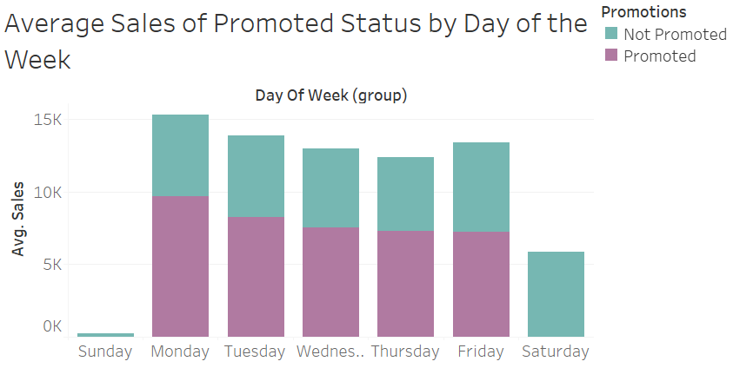

Slide 9
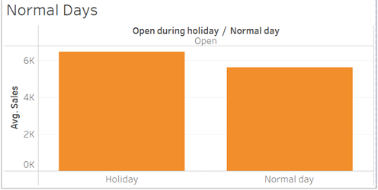

Slide 10
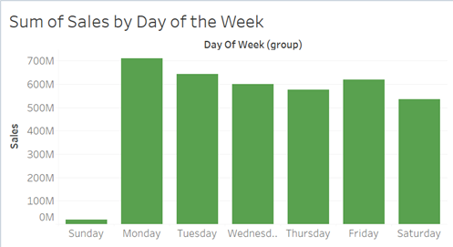

Slide 11
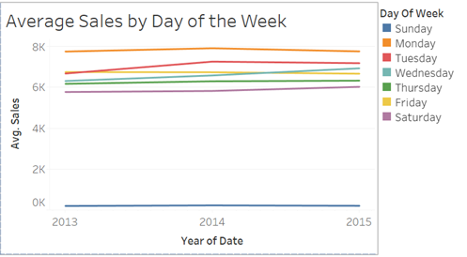

Slide 12
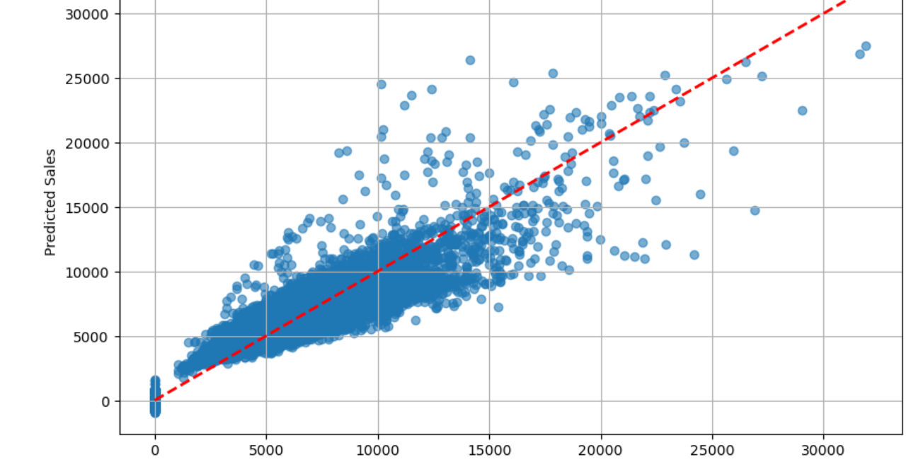

Slide 13
Machine Learning Model

Slide 14
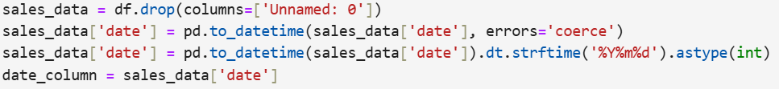
Steps Taken to Prepare Data Base
Changing the date column into an int for the data modeling.

Slide 15
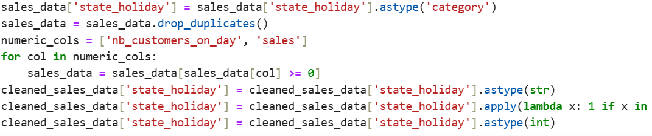

Steps Taken to Prepare Data Base
Changing the state_holiday column into a binary array because of string issue

Slide 16
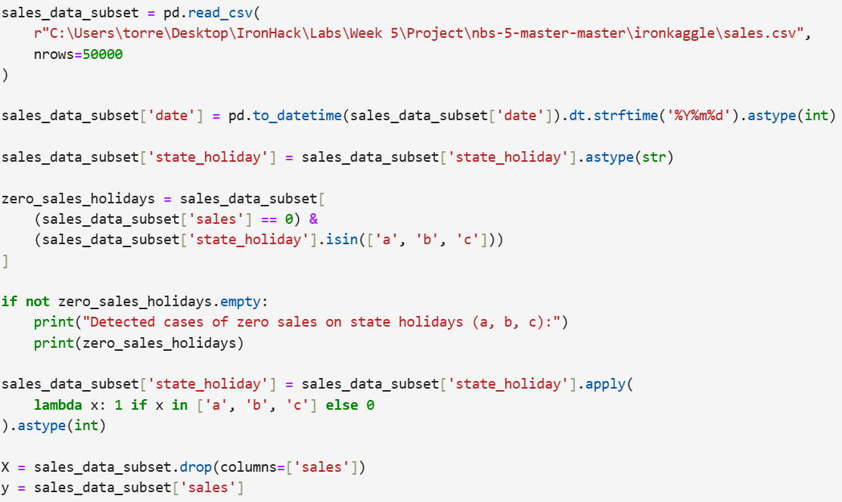
Training the Model

Slide 17
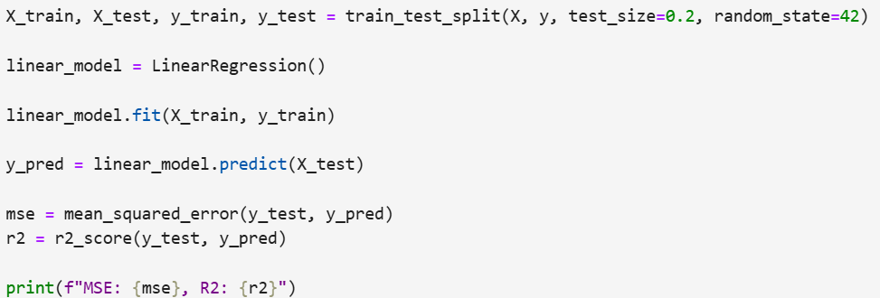
Training the Model

Slide 18
Model Predictability
The model explains 84.87% of the variance in sales.
Mean Squared Error (MSE): 2,592,134
This indicates the average squared error between predicted and actual sales. The high value reflects the large range of sales in the dataset, which is expected for sales data.

Slide 19
Conslusions

Slide 20
Store ID 948 was the most active during holidays, being open on 23 holidays, but its total sales (3,959,988) were not among the highest, suggesting that being open on holidays alone does not guarantee higher overall sales.
Since Sundays had highest sales, this suggests that weekend sales drive significant revenue, and promotions or extended hours during these days could amplify sales.

Slide 21
Stores with the lowest sales (e.g., Store ID 307) could increase revenue by strategically opening on high-sales holidays.
Since customer count strongly correlates with sales, marketing efforts (promotions, loyalty programs) targeting increased footfall on slower days could boost overall sales.

Slide 22

Thank you!

